Slide 1
Network and Cyber Security-I (CY2001) (Lecture 5 and 6)
Dr. Qaisar Shafi
Department of Computer Science,
National University of Computer & Emerging Sciences, Islamabad Campus

Slide 2
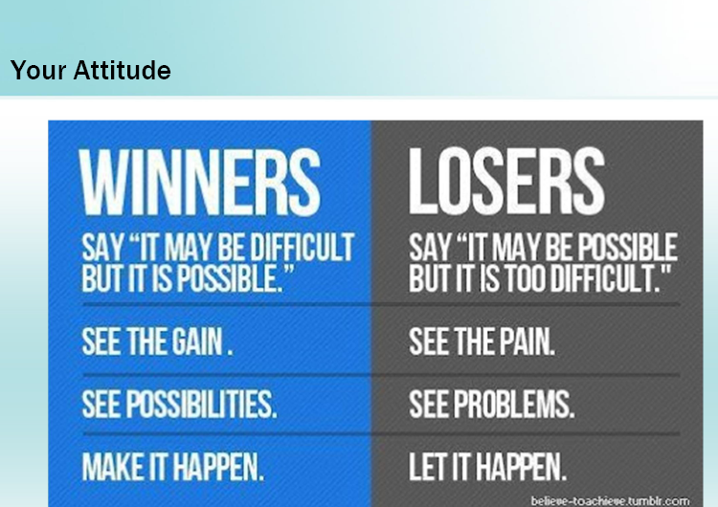

Slide 3
Weekly Motivation
The most beautiful people we have known are those who have known defeat, known suffering, known struggle, known loss, and have found their way out of the depths. These persons have an appreciation, sensitivity, and an understanding of life that fills them with compassion, gentleness, and a deep loving concern. Beautiful people do not just happen. - Elizabeth Kubler Ross

Slide 4
Symmetric Ciphers (continue..)

Slide 5
Playfair Cipher
Invented by charles wheatstone in 1854
The best known multiple-letter encryption.
Treat digrams in the plaintext as single units and translate these units into ciphertext.
Based on 5x5 matrix letters , using keyword.

Slide 6
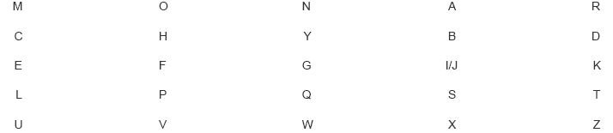
Playfair cipher

Slide 7
Playfair cipher
In this case, the keyword is monarchy.
The plaintext is encrypted according to the following rule.
Two letters that fall in the same row are replaced by letters to the right , with the first element of the row circularly following the last. E.g ar is encypted by RM.
Two plaintext that fall in the same column are replaced by letters beneath , the top element of the column circularly following the last e.g mu is encrypted as CM.

Slide 8
Playfair Cipher
Each , plaintext letter in a pair is replaced by the letter that lies in its own row and the column occupied by the other plaintext letter, thus hs becomes BP and ea becomes IM (or JM )
Repeating plaintext letters that are in the same pair are separated with a filler letter, such as x, so that balloon would be treated as ba lx lo on.
Simple monoalphbetic ciphers only 26 letters, 26x26= 676 digrams(identification is difficult).
Making relative frequency difficult.

Slide 9
Hill Cipher
Multi-letter cipher
Developed by Lester hill in 1929.
The encryption takes m successive plaintext letters and substitute for them m cipher letters.
The substitution is determined by m linear equations , each character is assigned a numerical value.

Slide 10

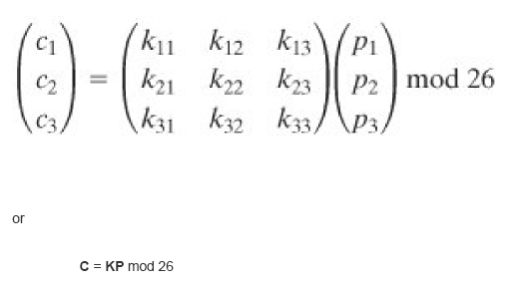
Hill cipher

Slide 11
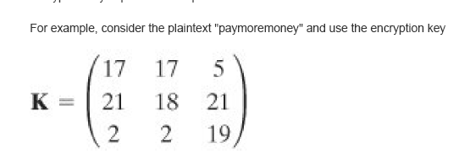
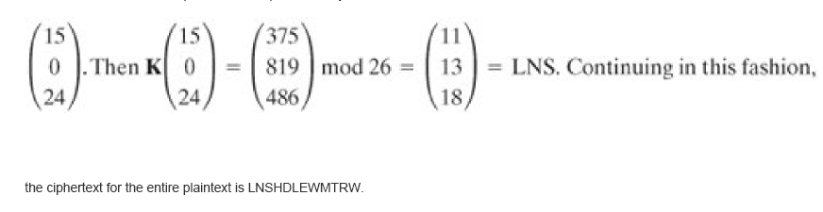
Hill Cipher

Slide 12
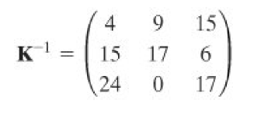
Hill Cipher
Decryption is the inverse of the matrix K.
The inverse K⁻¹ of a matrix is defined by the equation KK⁻¹=K⁻¹K=I

Slide 13
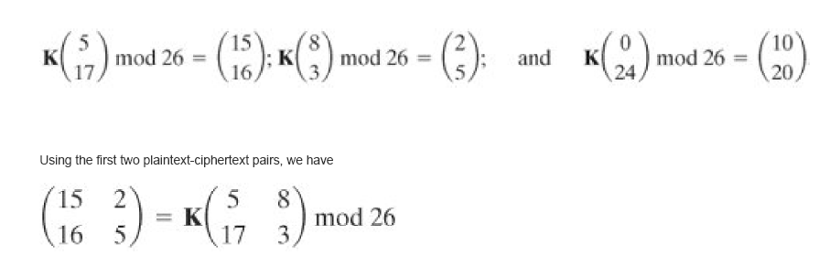
Cryptanalysis of Hill Cipher
Hill cipher is strong against a cihertext-only attack .
But it is easily broken with a known plaintext-attack .
Suppose the plaintext “Friday” is encypted using 2x2 hill cipher , yield cipher-text PQCFKU.

Slide 14
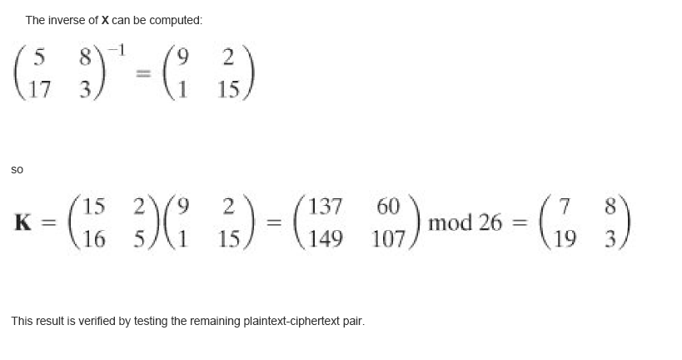
Cryptanalysis of Hill Cipher

Slide 15
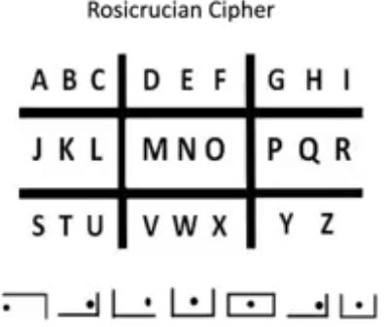
Rosicrucian Cipher

Slide 16
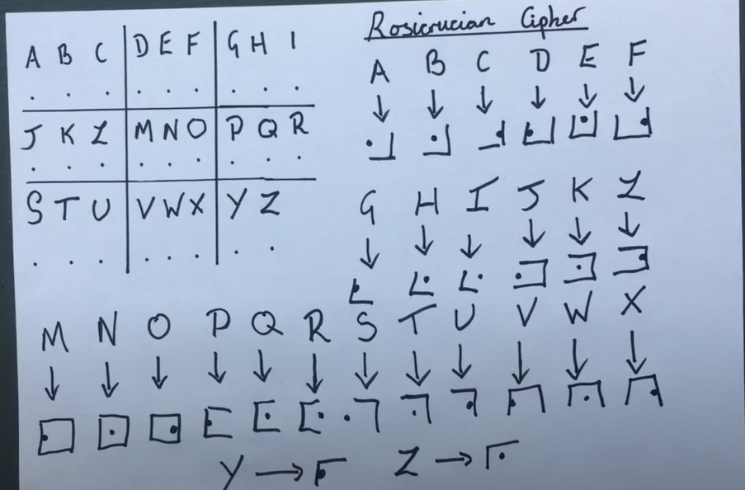
Rosicrucian Cipher(taken from YouTube Video)

Slide 17
Polyalphabetic ciphers
The simple substitution cipher is weak because the attacker can exploit the fact that:
The letter frequency distribution of the ciphertext will match the letter frequency distribution of the plaintext
These will generally follow the letter frequency distribution of the plaintext language
A simple way to defeat frequency analysis is to encipher each plaintext letter with a different substitution alphabet
The use of multiple substitution alphabets will mean that a plaintext letter can encrypt to different ciphertext letters, thus causing the letter frequency distribution to appear “flatter”
A cipher that uses multiple substitution alphabets is called a polyalphabetic substitution cipher

Slide 18
Vigènere cipher
The Vigènere cipher is a polyalphabetic substitution cipher
A secret word or phrase, representing the key, is agreed by the sender and receiver
Each letter of the key is used to encrypt a plaintext letter using the Caesar cipher; each key letter represents the “shift” amount (i.e., A=0, B=1, …, Z=25).
After the final key letter is used to encrypt a plaintext letter, the first key letter is used (again) to encrypt the next plaintext letter, and the cipher continues like this; this type of cipher is called repeated key.

Slide 19
Vigènere tableau
A B C D E F G H I J K L M N O P Q R S T U V W X Y Z
B C D E F G H I J K L M N O P Q R S T U V W X Y Z A
C D E F G H I J K L M N O P Q R S T U V W X Y Z A B
D E F G H I J K L M N O P Q R S T U V W X Y Z A B C
E F G H I J K L M N O P Q R S T U V W X Y Z A B C D
F G H I J K L M N O P Q R S T U V W X Y Z A B C D E
G H I J K L M N O P Q R S T U V W X Y Z A B C D E F
H I J K L M N O P Q R S T U V W X Y Z A B C D E F G
I J K L M N O P Q R S T U V W X Y Z A B C D E F G H
J K L M N O P Q R S T U V W X Y Z A B C D E F G H I
K L M N O P Q R S T U V W X Y Z A B C D E F G H I J
L M N O P Q R S T U V W X Y Z A B C D E F G H I J K
M N O P Q R S T U V W X Y Z A B C D E F G H I J K L
N O P Q R S T U V W X Y Z A B C D E F G H I J K L M
O P Q R S T U V W X Y Z A B C D E F G H I J K L M N
P Q R S T U V W X Y Z A B C D E F G H I J K L M N O
Q R S T U V W X Y Z A B C D E F G H I J K L M N O P
R S T U V W X Y Z A B C D E F G H I J K L M N O P Q
S T U V W X Y Z A B C D E F G H I J K L M N O P Q R
T U V W X Y Z A B C D E F G H I J K L M N O P Q R S
U V W X Y Z A B C D E F G H I J K L M N O P Q R S T
V W X Y Z A B C D E F G H I J K L M N O P Q R S T U
W X Y Z A B C D E F G H I J K L M N O P Q R S T U V
X Y Z A B C D E F G H I J K L M N O P Q R S T U V W
Y Z A B C D E F G H I J K L M N O P Q R S T U V W X
Z A B C D E F G H I J K L M N O P Q R S T U V W X Y
If n is the length of the key, then:
C_{i} = P_{i} + K _{(i + n) mod n}
Example:
Plaintext letter: T
Key letter: N
T = 19, N = 13
C = 19 + 13
= 32
= 6 (mod 26)
Ciphertext letter: G

Slide 20
One-time pad
Using the random keys that is as long as the message , so that the key need not to be repeated.
The key used to encrypt and decrypt a single message is discarded.
Each need message requires a new key of the same length as the new message.
Know as One-time pad, is unbreakable.
Produces random output that bears no statistical pattern to the plaintext, because ciphertext no information about plaintext, there is simply no way to break the code.

Slide 21
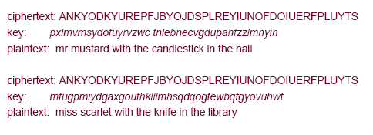
Example one-time pad
Suppose attacker managed to find these two keys, how to decide which is the correct decryption.
Infact , given a plaintext of equal length to the cipher-text , there is the key that produces that plaintext.
Therefore, if you do your EKS , you will come across many legible plaintext.
The security of OTP , lies in randomness of keys.
Stream , is truly random, and thus ciphertext is truly random.

Slide 22
Fundamental difficulties associated with OTP
Practical problem of making large quantities of random keys.
Problems of key distribution and protection, for every message to be sent , a key of equal length is needed by both sender and receiver.

Slide 23
Transposition cipher (Railfence cipher)
A transposition cipher rearranges the plaintext letters according to a secret transformation defined by the key.
The simplest example of this is the railfence cipher, in which the plaintext is written in rows of n-letter blocks (the number of columns n is the key) and then the ciphertext is read in columns
Example:
Plaintext: TRANSPOSITIONCIPHERX
In this example, the key is: 5
Re-write as rows of 5-letter blocks:
TRANS
POSIT
IONCI
PHERX
Ciphertext: TPIPROOHASNENICRSTIX

Slide 24
Transposition cipher
Problems with the railfence cipher:
The first and last letters of the plaintext do not move
The key is a number that divides the total message length
In a single columnar transposition cipher, the key is a word or phrase whose letters, in alphabetic order, indicate the order of the columns as they are read
Example:
Plaintext: TRANSPOSITIONCIPHER
Key is “SECRET”, so re-write as rows of 6-letter blocks:
SECRET CEERST
521436 123456
TRANSP ARSNTP
OSITIO ISITOO
NCIPHE ICHPNE
R R
Ciphertext: AIIRSCSIHNTPTONRPOE

Slide 25
Steganography
Conceal of message
Time-consuming to construct

Slide 26
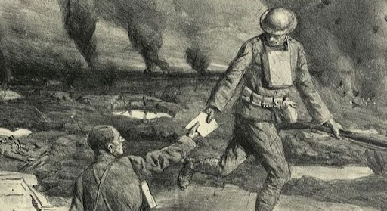
Runner

Slide 27
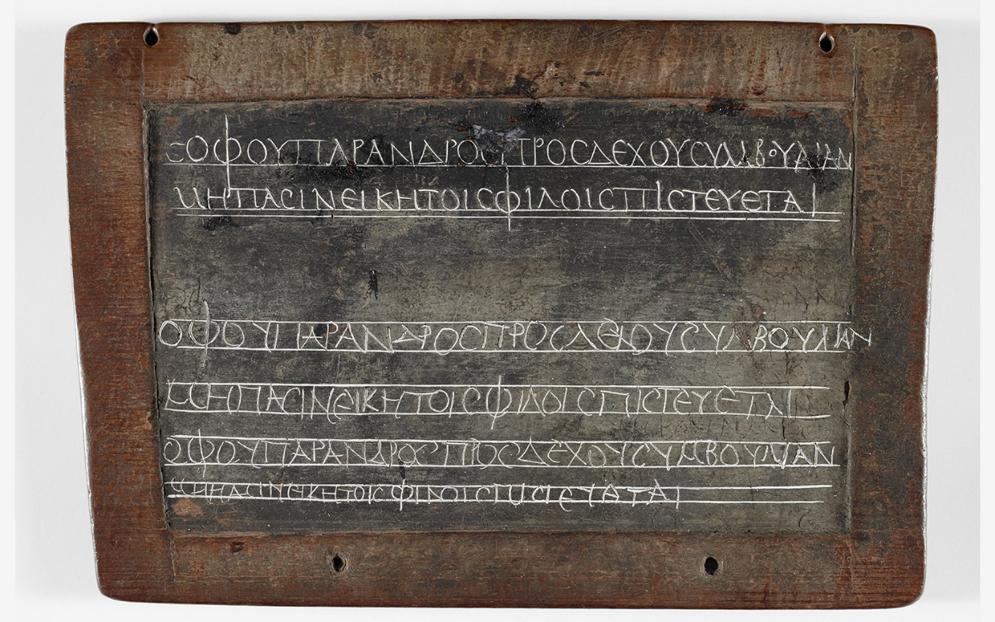
Wax Tablet

Slide 28
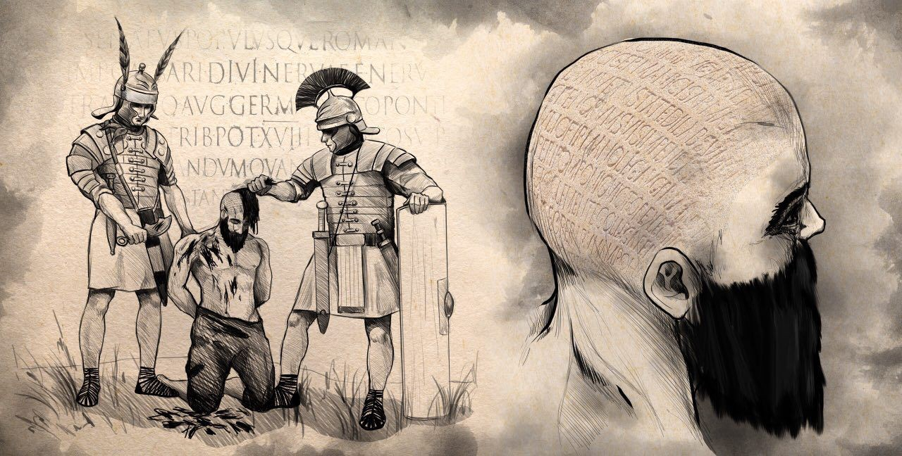
Messenger

Slide 29

Invisible Ink

Slide 30
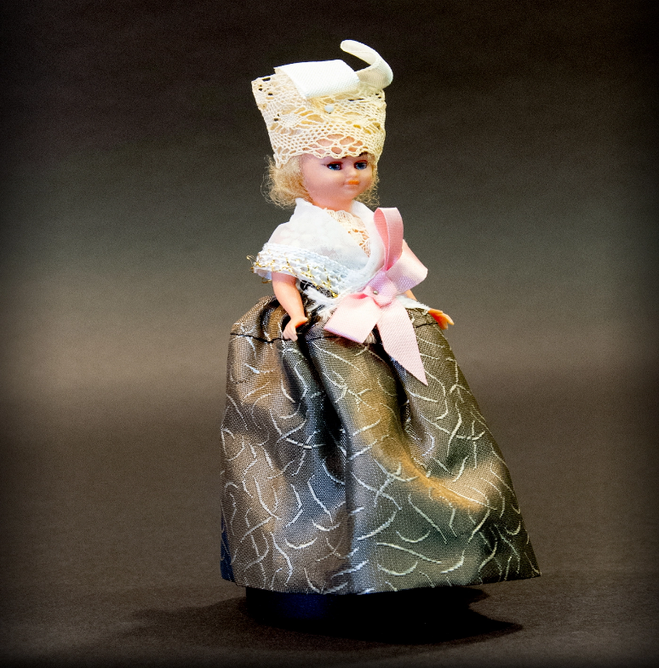
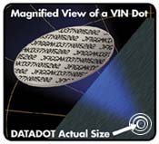
Microdots

Slide 31
Hiding message within text
An actual message from a German spy
read second letter in each word
“Apparently, neutral’s protest is thoroughly discounted and ignored. Isman hard hit. Blockade issue affect pretext for embargo on by products, ejecting suets and vegetable oils.”
“Pershing Sails from NY June 1”

Slide 32
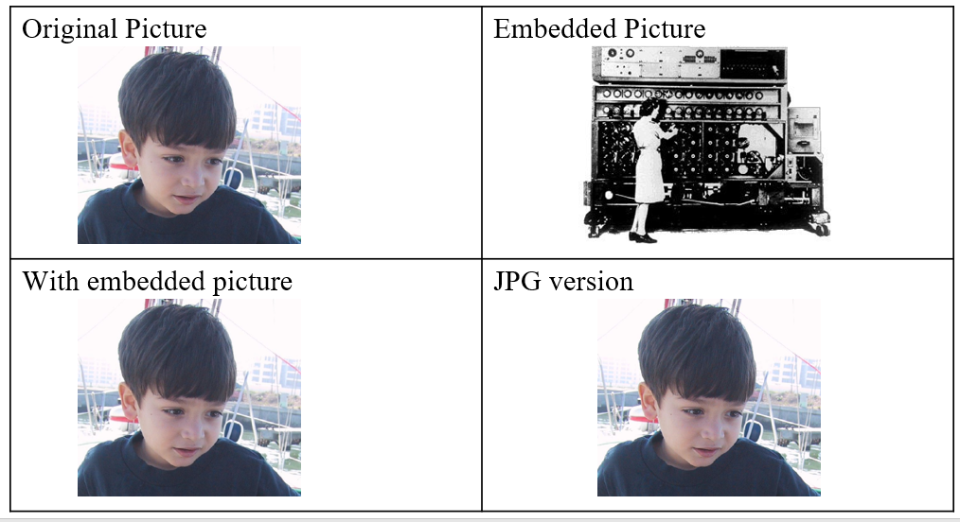

Modern Steganography (image, audio, video, html, exif)

Slide 33
Techniques of steganography
Character marking
Selected letters of printed or typewritten text are overwritten in pencil. The marks are ordinarily not visible unless the paper is held at an angle to bright light.
Invisible ink
Substances used for writing , but leaves no leaves no visible trace until some chemical is applied.
Pin punctures
Small pin punctures on selected letters are not visible unless held up in front of light.
Typewriter correction ribbon
Used between lines typed with a black ribbon , the results of typing with the correction tape are visible only under strong light.

Slide 34
Lessons from cryptanalysis
The security of the cipher should depend entirely on the key (i.e., we should assume that the attacker knows how the cipher works); this is known as Kerckhoffs’ principle
The a large key space only makes exhaustive key search impractical; it does not mean that the cipher cannot be broken by some other method

Slide 35
END OF LECTURE

Slide 36
Any Questions ?

